Slide 1

Dbt Training -Advanced Test
Ann Liou
Tai-Yee.liou@ibm.com
Created: 2024/11/25
Updated: 2024/11/25

Slide 2
AGENDA
Overview
Introduction
What to Test
When to Run Test
Test Coverage
Type of test (by defined methods)
Q & A

Slide 3
Prerequisites
Environment
Python/conda
dbt-core, dbt-postgres
Podman desktop
DBeaver
git client
visual code, addon
Better Jinja
yaml
Training:
dbt-quickstart
Jinja-101

Slide 4
AGENDA
Overview
Introduction
What to Test
When to Run Test
Test Coverage
Type of test (by defined methods)
Q & A

Slide 5
Quick refresher: what are tests?
Tests are assertions you make about your models and other resources in your dbt project (e.g., sources, seeds and snapshots).
dbt ensures data quality through a testing framework.

Slide 6
Quick refresher: why test?
Feel comfortable and confident in the code you are writing
Ensure your code continues to work as expected
To help data consumers make data-informed decisions on accurate data
To increase the likelihood of success
To build trust in the platform
Save time as models documented with assertions helps future you (and others) contribute to the codebase

Slide 7
Testing Techniques：interactive query
interactive / ad hoc queries
Example query to test the primary key in a statement tab
-- ad hoc query in statement tab
select
customer_id
from analytics.customers
group by customer_id
having count(*) > 1

Slide 8
Testing Techniques：standalone saved query
Standalone saved query
Example of a standalone test. Add the previous statement to a SQL file and it will run when you want to check the results.
# assert_unique_customers_customer_id.sql
select
customer_id
from analytics.customers
group by customer_id
having count(*) > 1

Slide 9
Testing Techniques：standalone saved query
Expected results
Example of a standalone test with expected results. This adds context and information to your tests.
# additional logic to only surface failures
select
count(*) as failures
from (
select
customer_id as unique_field,
count(*) as n_records
from analytics.dbt_pkearns.customers
where customer_id is not null
group by customer_id
having count(*) > 1
) dbt_internal_test

Slide 10
Testing Strategies
Test on a Schedule The ultimate goal is a standalone test w/ expected results running automatically on a schedule.
Take Action! Failures should be fixed immediately or silenced. If there is too much noise, tests become meaningless.

Slide 11
What makes a good test?
Automated | low effort / repeatable
Fast | if testing takes too long, no one will do it
Reliable | believe them when they say something does work
Informative | leave you clues about what to fix based on the error
Focused | every test should validate one assumption

Slide 12
AGENDA
Overview
Introduction
What to Test
When to Run Test
Test Coverage
Type of test (by defined methods)
Q & A

Slide 13
Test on One Database Object
What / Why
Assert something about the data that you think is true
Contents of the data
Constraints of the table
The grain of the table
Example Tests
unique
not_null
accepted_values
Other package’s tests like:
dbt_expectations.expect_column_proportion_of_unique_values_to_be_between

Slide 14
Test How One Database Object Refers to Another Database Object
What / Why
Compare values in one model to a source of truth in another model
Ensure data has neither been erroneously added or removed
Example Tests
relationships
Other package’s tests like:
dbt_utils.equality
dbt_expectations.expect_table_row_count_to_equal_other_table

Slide 15
Test Something Unique About Your Data
What / Why
Tests usually involve some business logic, edge case, or rare event
Example Tests
Orders should have payments >= 0
Billing Total should equal the sum of all parts: subtotal + tax + credits … = Total

Slide 16
Test the Freshness of Your Raw Source Data
What / Why
See if your loading tool has added raw data to your source table in the last X hours.
Get notified if your underlying raw source data is not up to date.
Consider as the first step in your job to prevent models from running if data is delayed.
Example Tests
Freshness tests
Run by dbt source freshness command

Slide 17
Temporary Testing While Refactoring
What / Why
Create confidence
Efficiently refactoring
Auditing your changes while in development
Example Tests
audit_helper package to compare your new refactored model to your existing legacy model

Slide 18
The path to a well-tested dbt project
L1 Infancy | No tests
L2 Toddlerhood | Primary key testing on your final models
L3 Childhood | N=5 tests per model
L4 Adolescence | Add advanced tests from packages
L5 Adulthood | High test coverage; advanced testing strategies

Slide 19
AGENDA
Overview
Introduction
What to Test
When to Run Test
Test Coverage
Type of test (by defined methods)
Q & A

Slide 20
Run Tests
Manual
When you first run a project
During development
Automated
When you run dbt on a schedule (deployment jobs!)
When you want to merge your code (git CI checks!)

Slide 21
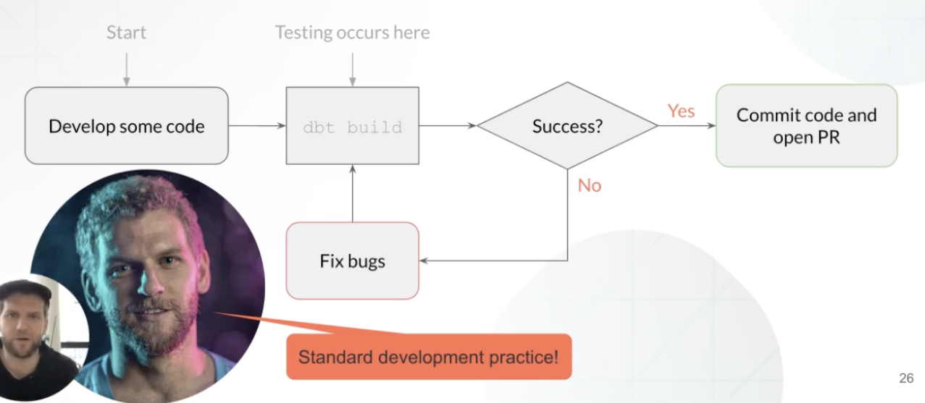
#1: Test while adding or modifying dbt code

Slide 22
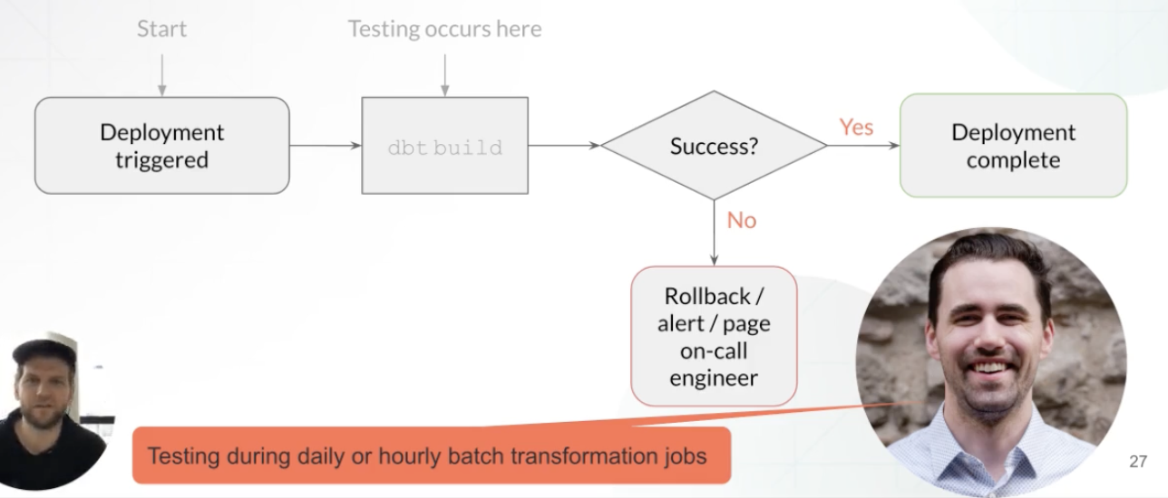
#2: Test while deploying data to production

Slide 23
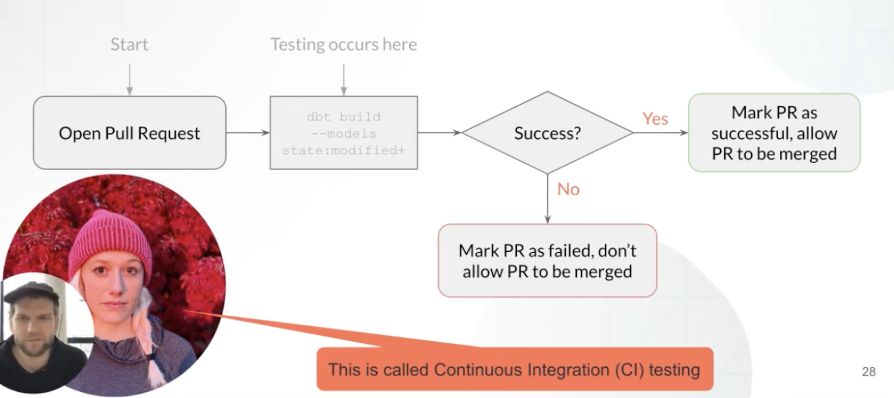
#3: Test while opening pull request (CI)

Slide 24
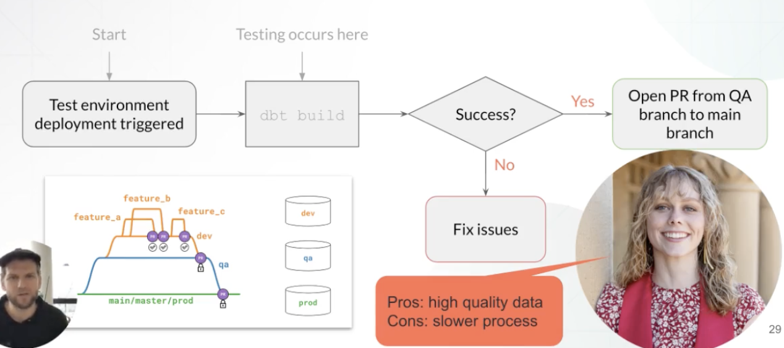
#4: Test in QA branch before your dbt code reaches main

Slide 25
AGENDA
Overview
Introduction
What to Test
When to Run Test
Test Coverage
Type of test (by defined methods)
Q & A

Slide 26
dbt_project.yml
models
│
├── marts
│ ├── core
│ │ ├── _core.md
│ │ ├── _core.yml
│ │ ├── dim_customers.sql
│ │ └── fct_orders.sql
│ ├── intermediate
│ ├── _intermediate.yml
│ ├── customer_orders__grouped.sql
│ ├── customer_payments__grouped.sql
│ └── order_payments__joined.sql
│
├── finance
├── marketing
├── product
├── staging
├── github
│ ├── _github.yml
│ ├── stg_github__commits.sql
│ └── stg_github__issues.sql
├── slack
└── zendesk
Project Tests
Tests defined:
In dbt_project.yml file.
Tests act on:
Your whole project, to test whether you have defined tests (or documentation) within your *.yml files.
To run test:
dbt run-operation.
GitHub action.
When:
Development adhoc.
During continuous integration checks.
Notes:
全局的測試
會被定義在 dbt_project.yml 上

Slide 27
dbt_project.yml
models
│
├── marts
│ ├── core
│ │ ├── _core.md
│ │ ├── _core.yml
│ │ ├── dim_customers.sql
│ │ └── fct_orders.sql
│ ├── intermediate
│ ├── _intermediate.yml
│ ├── customer_orders__grouped.sql
│ ├── customer_payments__grouped.sql
│ └── order_payments__joined.sql
│
├── finance
├── marketing
├── product
├── staging
├── github
│ ├── _github.yml
│ ├── stg_github__commits.sql --> raw.github.commits
│ └── stg_github__issues.sql --> raw.github.issues
├── slack
└── zendesk
Source Freshness Tests
Tests defined:
In staging/*.yml files.
Tests act on:
A declared column in the underlying raw data about loading source or loading time
Example: _loaded_at.
To run test:
dbt source freshness.
When:
Production jobs.
To decode if run downstream models
Notes:
測試資料源有沒有被更新，會放在 staging 裡面
通常是針對時間性欄位做檢查
執行的指令也不一樣
可以放在 model 的最前面，當作是否要執行 model 的依據，如果時間沒有更新，那就不要執行 model
通常設定會被放在 _.yml 裡面去執行

Slide 28
dbt_project.yml
models
│
├── marts
│ ├── core
│ │ ├── _core.md
│ │ ├── _core.yml <---
│ │ ├── dim_customers.sql <---
│ │ └── fct_orders.sql <---
│ ├── intermediate
│ ├── _intermediate.yml
│ ├── customer_orders__grouped.sql <---
│ ├── customer_payments__grouped.sql <---
│ └── order_payments__joined.sql <---
│
├── finance
├── marketing
├── product
├── staging
├── github
│ ├── _github.yml
│ ├── stg_github__commits.sql <---
│ └── stg_github__issues.sql <---
├── slack
└── zendesk
Generic Tests
Tests defined:
In YAML files.
Tests act on:
Columns in raw data.
Columns in a model.
To run test:
dbt test
dbt build
When:
Development adhoc.
Production jobs.

Slide 29
dbt_project.yml
models
│
├── marts
│ ├── core
│ │ ├── _core.md
│ │ ├── _core.yml
│ │ ├── dim_customers.sql
│ │ └── fct_orders.sql
│ ├── intermediate
│ ├── _intermediate.yml
│ ├── customer_orders__grouped.sql
│ ├── customer_payments__grouped.sql
│ └── order_payments__joined.sql
│
├── finance
├── marketing
├── product
├──test
├──test_order.sql
└──test_customer.sql
Specific Test
No one write them before
Specific to certain models
Notes:
特殊的測試，和general 測試不一樣，沒有人寫過，高度客製化，最下面那兩個

Slide 30
AGENDA
Overview
Introduction
What to Test
When to Run Test
Test Coverage
Type of test (by defined methods)
Q & A

Slide 31
Type of Tests (by defined method)
category | defined | Test sql location | Test type
Native test | .yml in models folder | dbt core code | test function | Not_null Unique can be overwrite by tests in tests/generic/
Package Test | .yml in models folder | dbt_packages/ | test function | dbt_utils.expression_is_true
Singular test | -- | tests/ | specific modes | assert_column_greater_than_five
Generic Test | .yml in models folder | macros/ tests/generic/ | as test function | fct_orders_amount_greater_than_five

Slide 32
Singular Tests
Singular tests are built when you want to test an assumption about particular models.
The test should return any rows that fail the assumption.
All you need is a SELECT statement in a new .sql file stored in the /tests/ folder.
-- this singular test tests the assumption that the amount column
-- of the orders model is always greater than 5.
select
amount
from {{ ref('orders') }}
where amount <= 5

Slide 33
Generic Tests
What are other examples of generic tests? You’ve already learned them! They are native to dbt and you can apply them to any model:
UNIQUE
NOT_NULL
ACCEPTED_VALUES
RELATIONSHIPS
-- this is the not_null test, under the hood!
{% test not_null(model, column_name) %}
select *
from {{ model }}
where {{ column_name }} is null
{% endtest %}

Slide 34
Custom Generic Tests - Example
{% test greater_than_five(model, column_name) %}
select
{{ column_name }}
from {{ model }}
where {{ column_name }} <= 5
{% endtest %}
select
amount
from {{ ref('orders') }}
where amount <= 5

Slide 35
Overwriting native tests
You can overwrite any test that dbt ships with. In fact, you can overwrite any macro that dbt utilizes!
Why would you do this? You may want to test for not-null-ness only under certain circumstances across your entire project, like when the column_id is not your test case, i.e., not equal to 00000.

Slide 36
Overwrite Native Tests Example
-- this is the not_null test
{% test not_null(model, column_name) %}
select *
from {{ model }}
where {{ column_name }} is null
{% endtest %}
-- this is the not_null test, with a mod!
{% test not_null(model, column_name, column_id) %}
select *
from {{ model }}
where {{ column_name }} is null
and {{ column_id }} is not in ('00000')
{% endtest %}

Slide 37
Q&A

